Slide 1
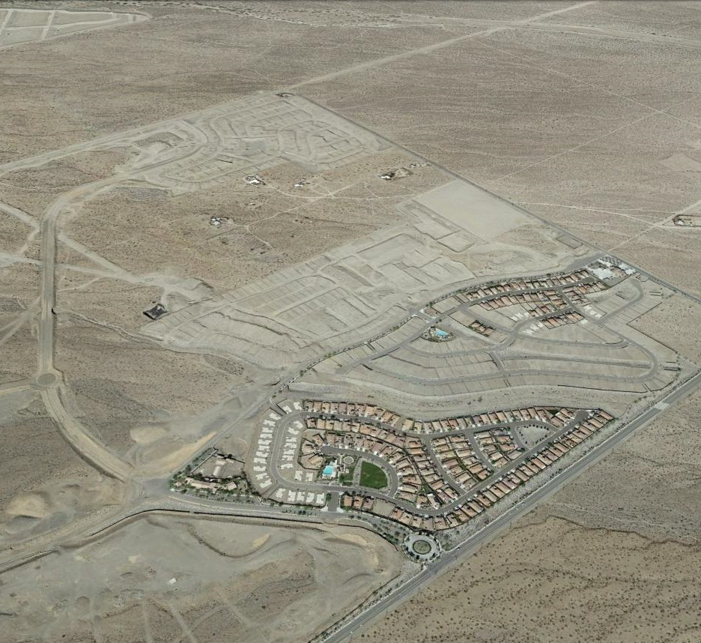


CORNERSTONE
12671 High Bluff Drive, Suite 150
San Diego, California, 92131
P: 858-523-0719
F: 858-523-0826
www.lansingcompanies.com

Slide 2
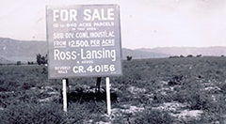
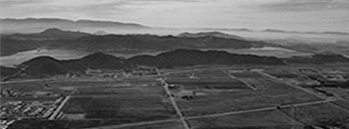

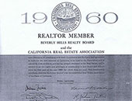
"It all starts with land."
Ross Lansing, President
Lansing & Associates
Founded in 1984, Lansing Companies is the leading expert in Southern California land development. Our executive principals each average over 30 years of experience in all aspects of this specialized market. This practical expertise, combined with integrity, creativity, and perseverance, has produced consistent, substantial returns for our investors and partners.
Lansing Companies has acquired, developed, and sold properties and currently owns and manages more than 20,000 lots and more than 35,000 acres throughout the Southwest. Our master-planned communities are well known for their distinctive character and life-enhancing amenities. Lansing Companies also leads the way in renewable energy land development in the Western United States.
We are a comprehensive land development company, our persistence and follow through are all part of a successful formula, which includes among many other aspects, the following:
• Selection and acquisition of raw land without entitlements
• Strategic property planning that is both lucrative and appropriate for communities
• Administration of the entire entitlement process, including specific plans, general plan amendments, zone changes, tentative tract maps, infrastructure improvement plans, final tract maps, and the procurement of all permits and clearances
• Reworking of previously entitled projects, creating substantial additional value
• Securing of third-party or public financing, joint ventures, and other investments
• Collaboration with municipality staff, planning commission, design review boards, city council and neighboring communities and landowners to ensure a win-win outcome for all
• Obtaining bids, selection of contractors, negotiation of contracts, and overseeing of the design and development
• In-ground improvements including grading, sewer, water, storm drain systems, streets, masonry, and landscaping
• Marketing and sale of completed projects to builders or other wholesale or retail buyers

Slide 3
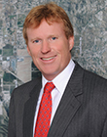
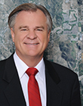
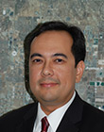
Gregory P. Lansing, President/CEO
As principal of Lansing Companies, Greg Lansing has over 30 years of experience in Southern California real estate development and is regarded as an expert in this niche market. Mr. Lansing leads the team in strategizing, planning, and acquisition. He also plays a lead role in negotiations, interfaces with city officials, oversees the selection of professional engineers, architects and consultants, and is responsible for overall management of Lansing Companies and its projects.
As a licensed real estate broker, Mr. Lansing has negotiated and brokered more than one billion dollars of land purchases and sales. Through hard work and persistence, he has established a tremendous network and valuable relationships within the brokerage, development, investment, and local political communities.
Scott E. McDaniel, Executive Vice President
Mr. McDaniel has more than 35 years of experience in the acquisition and entitlement of land in Southern California and has been involved in more than 500 land transactions with a combined value of over one billion dollars. He is Founder and President of Regal Development and is engaged in acquiring and joint venturing the development of large parcels of land in Southern California. He is currently a partner in the development of approximately 10,000 lots for sale to merchant builders and is in charge of acquisition, disposition, and strategic joint venture partners for these projects.
In 1968 Mr. McDaniel graduated from the U.S. Naval Academy and was commissioned 2nd Lieutenant in the U.S.M.C. He entered the Navy flight training program in 1969 and flew the F-4 Phantom II jet aircraft for the Marines until honorably discharged in November 1973.
TEAM LANSING
Mark M. Clairmont, General Counsel
For more than 14 years, Mr. Clairmont has served as counsel for developers, owners and managers of commercial real property in business, transactional and litigation matters. Additionally, Mr. Clairmont developed an expertise in real estate issues as they relate to railroads in his prior representation of Union Pacific Railroad Company throughout California. In 2002, Mr. Clairmont successfully litigated a quiet title action on behalf of Union Pacific Railroad Company, which resulted in the Second Appellate District upholding the constitutionality of California's Marketable Record Title Act for the first time in California's history. 101 Cal.App.4th 1209. As General Counsel for Lansing Companies, Mr. Clairmont is responsible for all legal matters relating to company operations and projects. Mr. Clairmont obtained his law degree from the University of San Diego School of Law and is a California licensed attorney.

Slide 4
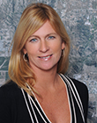
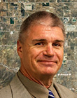
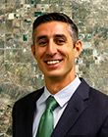
Katharina M. Houser, Chief Financial Officer
Katharina “Kathy” Houser brings 20 years of experience in Real Estate Development to Lansing Companies. Kathy has worked for Developer/Investor/Managers of multi-family, single family, commercial, fractional, and land developments. Kathy brings not only a wealth of real estate development experience but also has a background in HR, Information Technology and Operations. Kathy is responsible for all financial aspects of over 50 corporate entities including tax audit and compliance, cash flow management, financial and ROI analysis and risk management as well as being the primary liaison for bankers and lenders.
Kathy is a licensed CPA and earned her Bachelor of Arts with Honors as well as a Bachelor of Science in Accounting and Masters of Accounting Degrees at the University of Florida. Go Gators!
Will Roberts, Vice President of Land Acquisition & Development
For more than 30 Years, Mr. Roberts has worked in the Land Development industry specializing in the areas of Municipal, Commercial, Industrial, Hospitality, Aerospace and Residential. Mr. Roberts has spent his career on both sides of the table. First, in the Civil Engineering Industry for two top ten engineering firms working as a Project Manager, and second, as the Vice President of Land Development for a private billionaire developer, where Mr. Roberts oversaw the design and development of several thousand Hotel units in Las Vegas, Nevada, Phoenix, Arizona and the Dallas, Texas Metro Area. He also worked on the fifty acre Aerospace Campus with an emphasis on the future of Space Tourism. Furthermore, Mr. Roberts was previously Vice President of Land Development for two top five home builders where he oversaw the design and development of master planned communities throughout Las Vegas, Nevada and Mohave County, Arizona. Mr. Roberts has a passion for making the impossible into the possible with a strong emphasis on “VALUE ENGINEERING”.
TEAM LANSING
Paul W. Pitingaro, Esq., Associate General Counsel
Paul Pitingaro is Associate General Counsel for the Lansing Companies and is a California licensed attorney. He is responsible for all litigation matters and advises the company concerning risk management and compliance issues. Prior to joining the Lansing Companies, Mr. Pitingaro was a Senior Associate with the regional law firm, Bremer Whyte Brown & O’Meara LLP, where he represented property managers, developers, contractors, retailers and manufacturers in all phases of litigation, as well as in transactional matters. Mr. Pitingaro earned his J.D. from Thomas Jefferson School of Law, graduating cum laude with a Certificate in Global Legal Studies and served as a member of law review. He received his Bachelor of Arts in Archaeology from Boston University, interning at the Peabody Museum of Archaeology and Ethnology at Harvard University and serving as captain of the Boston University Rugby Team.

Slide 5
Casey Malone, Project Manager & GIS Analyst
Mr. Malone joined Lansing Companies in 2011 and handles a variety tasks related to property entitlements, due diligence, marketing, and investor relations. He obtained a B.A. in Geography from Humboldt State University in 2006 and GIS certification from Pennsylvania State University in 2010. He has been instrumental in utilizing the advancements in Geographic Information Systems (GIS) technology in support of property acquisitions and marketing. His project experience includes the entitlement of a 62 unit apartment complex in the community of Ramona where he worked closely with the community to gain support and approval for the project.
Michael Pagan, Director of Income Property Acquisitions
Mr. Pagan began his real estate career over 20 years ago while attending UCLA. Working as an analyst for a large REIT introduced him into commercial real estate. He excelled within underwriting, quality control, and risk management. Desiring an extensive knowledge base, Mr. Pagan moved into Asset Management with Wells Fargo where he served for a number of years. Subsequently, Michael embarked on his investment brokerage career with Marcus & Millichap in Los Angeles. While productively coordinating transaction over a number of years, the decision was made to move his family down to San Diego. Since that point, he has successfully enjoyed continuing his real estate career with developers and investment firms, specifically in the “value added” space.
TEAM LANSING
James Kozak – Strategic Partner
For more than 25 years, Jim Kozak has been a leader with a proven track record in the real estate industry. Throughout his career, Jim has participated in transactions worth hundreds of millions of dollars.
Leveraging his strengths as a creative problem solver and negotiator, Jim has successfully managed all aspects of the real estate development process. From raising capital and obtaining community approvals and entitlements, to sourcing opportunistic property sites for acquisition and managing construction activities, Jim is acknowledged by his peers as a person with an uncommon ability to discover, discern and create opportunity for his partners.

